Slide 1
Agile Methodologies
- Prof K G Krishna

Slide 2



Text/Reference Books
T1
T2
Compliments of IBM
➔ As this field is evolutionary, the student is advised to stay tuned to the current and emerging practices by referring to their own organization’s documentation as well as Net sources

Slide 3
Topics
Overview of Agile Methodologies
SCRUM
Extreme Programming (XP)
Test-Driven Development (TDD)

Slide 4
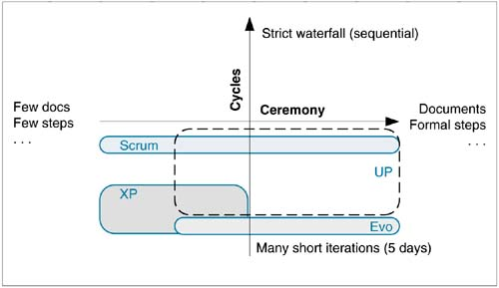
SCRUM on ‘Ceremony – Cycles’ Scale
Source: T1-Chap7

Slide 5
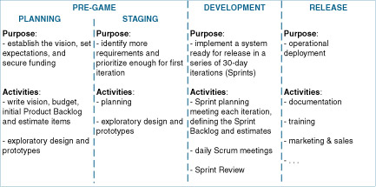
SCRUM Lifecycle
Source: T1-Chap7

Slide 6
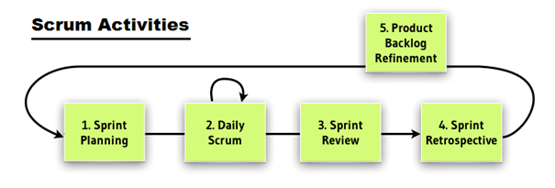
SCRUM Activities
Source courtesy: www.snyxius.com/how-to-run-scrum-planning-meeting-like-pro

Slide 7
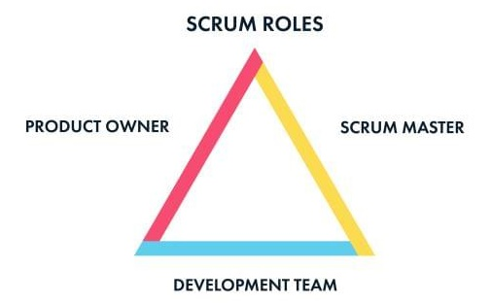
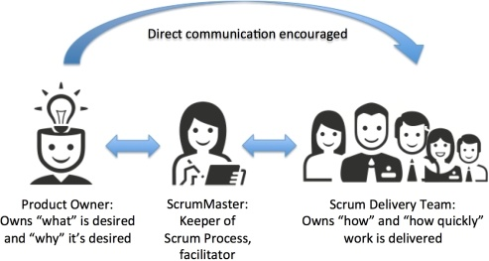
SCRUM – The Key Players

Slide 8
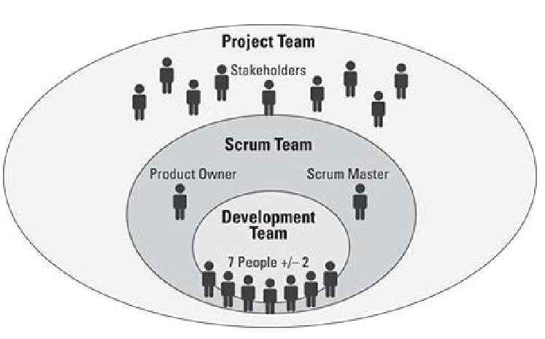
The ‘Extended’ SCRUM Team
+ Agile Coach
Source: (T2)

Slide 9
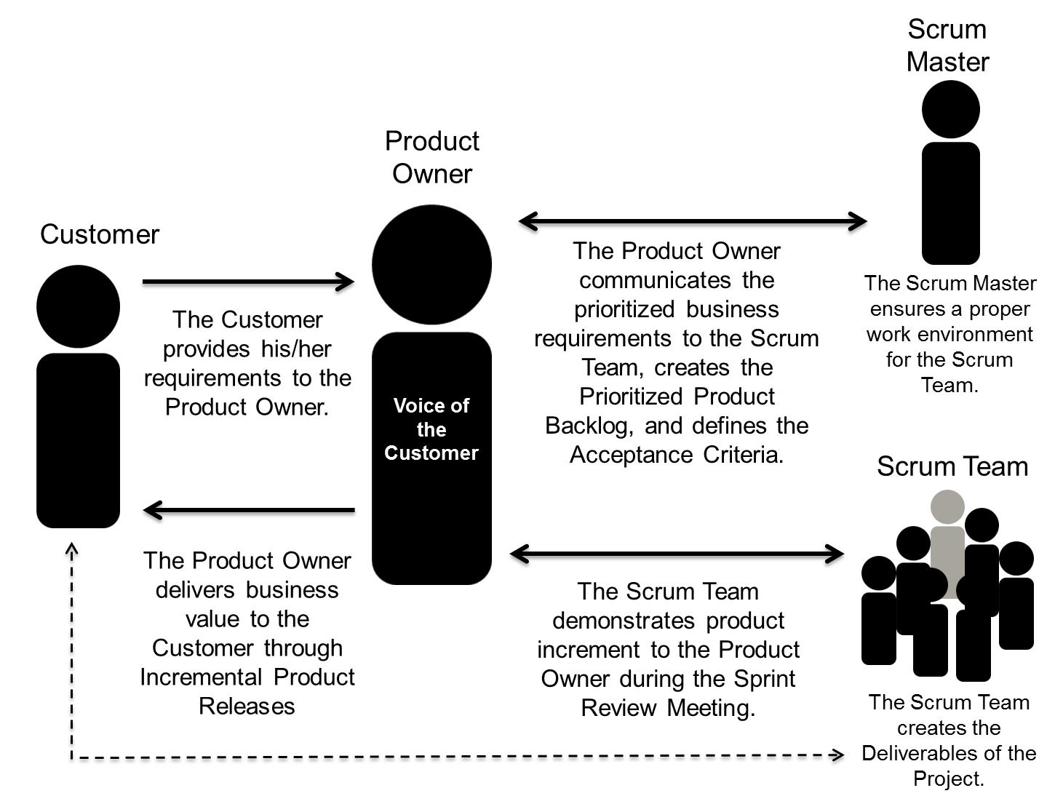
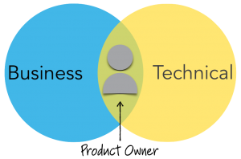
SCRUM Project Roles
Source courtesy: www.scrumstudy.com/blog/scrum-project-roles/

Slide 10
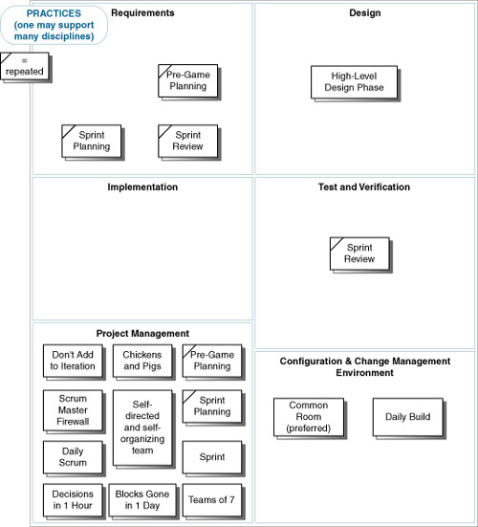
SCRUM Practices
Source: T1-Chap7

Slide 11
The Daily SCRUM Meeting –
The Heartbeat of the Project
Daily Standup Meetings (1 – 7 Members, 15 – 20 minutes)
Typical Questions Answered:
What have you done since the last Scrum?
What will you do between now and the next Scrum?
What is getting in the way (blocks) of meeting the iteration goals?
Any tasks to add to the Sprint Backlog? (missed tasks, not new requirements)
Have you learned or decided anything new, of relevance to some of the team members? (technical, requirements, …)
…
Non-Team Members (‘chickens’) Can’t Ask Questions – they just listen
White-board Meeting / Tele-Conf Call
Shared Responsibility and Team Cohesiveness is maintained

Slide 12
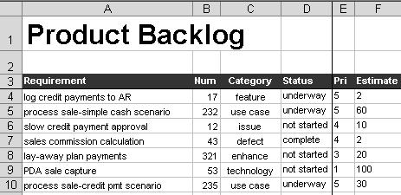
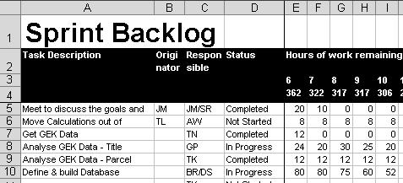
SCRUM Artifacts
Source: T1-Chap7

Slide 13
SCRUM Values
(“At the end, It’s the People that Matters the Most”)
Commitment: The Team given Authority and Autonomy to decide; The Product Owners commits to Product Backlog; The Scrum Master commits not to introduce new work items till Iteration is complete
Focus: The Scrum Master ensures the Team is not distracted; commits Resources and removes Roadblocks if any
Openness: Product Backlogs and Daily Progress of Work Items are Visible to the entire Team
Respect: Diversity of Individual Strengths and Weaknesses; facilitate Self-directed Teams; Teams empowered to seek/hire resources
Courage: The Team has the courage to take Decisions adaptively; Management is supportive by empowering Teams

Slide 14
SCRUM Drawbacks (discountable however!)
Active Engagement of the Customer: the customer has to be continually involved in the project; however, while this can be seen as an advantage, it requires a lot of time and effort to manage the process
High Visibility may lead to Scope Creep: as the Scrum methodology makes problems more visible, any problems arising at the end of each phase can also lead to "scope creep".
Small Teams losing Focus on the Big Picture: while Scrum encourages small teams, it implies that larger teams may have to be broken down into smaller sizes which could result in the smaller teams loosing sight of the overall project focus.
Increase of Project Cost: Scrum requires a certain level of training for all users which could increase the overall cost of the project.
…

Slide 15
Extreme Programming (XP) – A Set of Skillful Practices:
➔➔

Slide 16
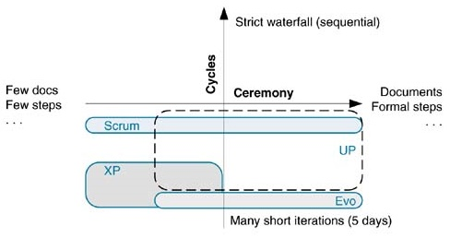
Extreme Programming (XP) – Core Values
Communication, Simplicity, Feedback, Courage
“Informal” (low on ‘ceremony’, usage of Story Cards)
Small Teams (<10)
Non-mission-critical Projects
Delivery Schedule <1 year
Source: T1-Chap8

Slide 17
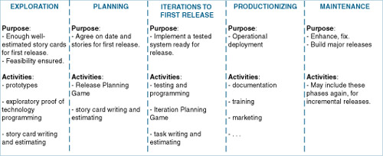
XP Lifecycle
Source: T1-Chap8

Slide 18
XP Core Practices (12)
Planning Game
Small, Frequent Releases
System Metaphors
Simple Design
Testing
Frequent Refactoring
Pair Programming
Team Code Ownership
Continuous Integration
Sustainable Pace
Whole Team Work together
Coding Standards

Slide 19
Pitfalls of XP
Requires presence of Onsite Customer or his/her Proxy
Relies on Informal oral understanding – difficult to ramp-up to speed new members or in large projects
XP practices are highly interdependent and tightly coupled—we can’t be selective in any
No ‘Standard’ means of documenting design
Pair programming may not be favoured by all – programmers are loners!
Lack of Focus on Architecture (relies on simple, if not fragile design and refactoring)

Slide 20

Extreme Programming (XP) Work Products
Minimalist approach towards Requirements Gathering: Story Cards (sketches, visuals, post-it notes,…) representing Features (not Use-cases/Scenarios) – just cue-cards for discussion
Task-list: containing Stories gathered for the Iteration (Task-card); Task-effort ~ 1-2 days
Visible Wall Graphs for all to communicate with each other—progress of Stories, Test-cases, etc. using Simple Metrics

Slide 21
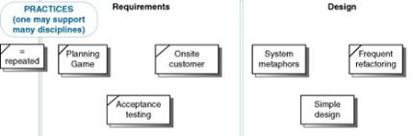
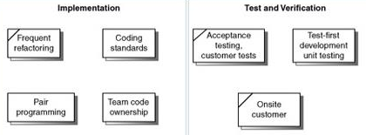
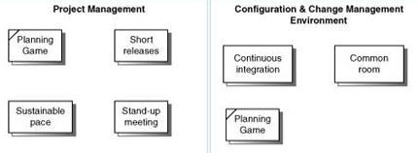
XP Practices
Source: T1-Chap8

Slide 22
XP – Other Common Practices/Values
Embrace Change with Onsite Customer
Volunteering rather than by Assignment
Light Modeling (Just enough to get stared)
Minimal Documentation
Daily Metrics (few vitals) for Progress Tracking
Incremental Infrastructure (no upfront investment)
Daily Standup Meetings
Simplicity – “Do the simplest thing that could possibly work.”
Communication promoted through Pair-programming
“The practices are what you do. The values are how you decide if you are doing it right.”

Slide 23
Test Driven Development (TDD): A Test-before-Code XP Practice
➔➔

Slide 24
Test-Driven Development
Writing Test-cases before Coding (Unit Tests are written before writing the Code to be tested)
Adoption of Short Iterative Development Cycle & Automated-Test Suites
Eliminates “coder bias”
“test with a purpose" - know why you are testing something and to what level it needs to be tested
“achieve 100% coverage test” – every single line of code is tested
“well-written unit-tests provide working specification of functional code” (code ~ documentation, tests ~ specifications)
“proxies”: (unit-tests ~ design specifications, acceptance-tests ~ requirements)

Slide 25
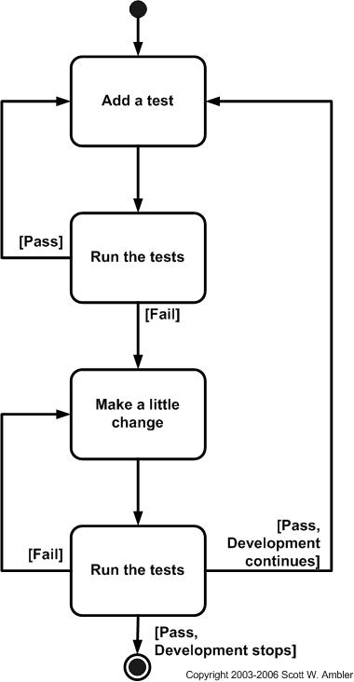
Test-Driven Development (TDD) =
Test-First Development (TFD) + Refactoring
CUnit
DUnit (Delphi)
DBFit
DBUnit
DocTest (Python)
Googletest
HTMLUnit
HTTPUnit
JMock
JUnit
Moq
NDbUnit
NUnit
OUnit
PHPUnit
PyUnit (Python)
SimpleTest
TestNG
TestOoB (Python)
Test::Unit (Ruby)
VBUnit
XTUnit
xUnit.net
Evolutionary Approach to Development
Write a Test-case first that fails before you write new functional Code; Coding evolves to fulfil those Test-cases, and then Refactor the Code
Is TDD an Agile Requirements Capture technique or Programming Technique (than a Validation technique)?
A Way to arrive at Clean Specifications!
Does NOT replace traditional Testing, ensures effective Unit Testing

Slide 26
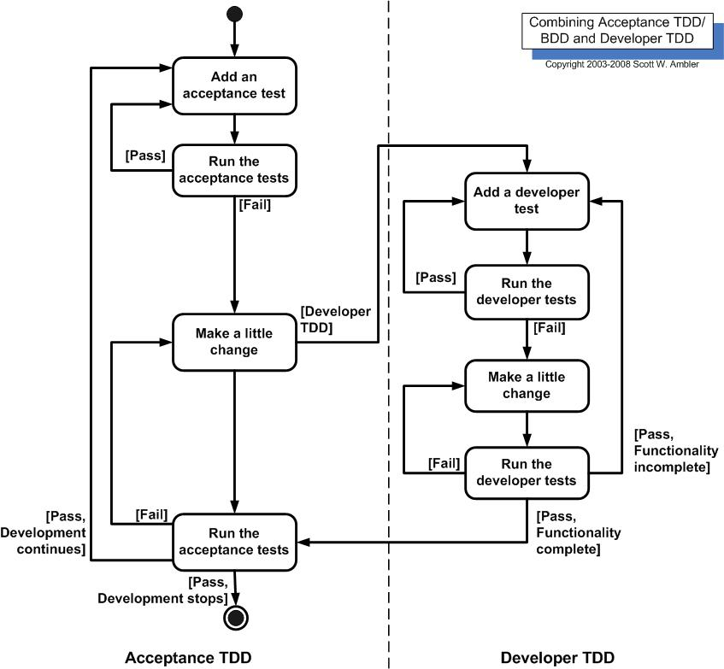
TDD: Acceptance TDD, Developer TDD
Source: http://agiledata.org/essays/tdd.html

Slide 27
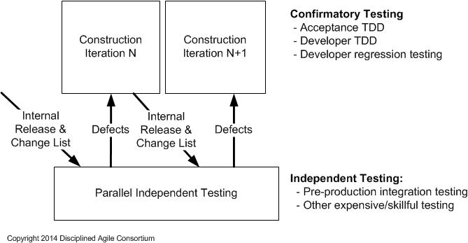
TDD is NOT an End to Itself…

Slide 28
Agile Methodologies - Summary
SCRUM is a Process in Agile Methodology which is a creative combination of an Iterative and Incremental Methods; it is prescriptive in nature and has well-defined Roles
XP – set of Practices that take Programming to the Extreme, i.e. just enough, just-in-time with minimalist approach; relies heavily on people
TDD – an XP technique turns traditional Code Development upside-down, i.e. write test first and then write (just enough) code to fulfil that test and move-on to write the next test, then code, etc.; relies on availability of automated test tools

Slide 29
Thank You
© Copyrights of original Authors are duly acknowledged
™ ® All Trademarks, Registered Trademarks referred in this document are the property of their respective owners

